Slide 1
Fitness Assistant
Team: Aishwarya and Uddaraju Varma
Team lead: Kishor Parida
Manager: Vipin Yadav

Slide 2
INDEX
What is Fitness Assistant?
How it is built?
Features of Fitness Assistant
Workflow
Architecture of Fitness Assistant
Advantages of Fitness Assistant
Working/ Demo

Slide 3
What is Fitness Assistant?
The main aim of this Fitness Assistant is to make its users active, fit, and healthy. For this, it offers personalized fitness training that can be done anywhere anytime. It turns your smartphone into a personal fitness trainer, that utilizes media pipe to track your fitness techniques.

Slide 4
How it is built?
We have used Flask web framework to build this web app .
Face recognition module for face login.
Mediapipe to track the exercise .

Slide 5
Features :
Face login for the web app
Food intake form
Demo of Exercise
IP Webcam provision
Tracking the exercise with proper posture
Automatic redirection from one exercise to other with a wait timer

Slide 6
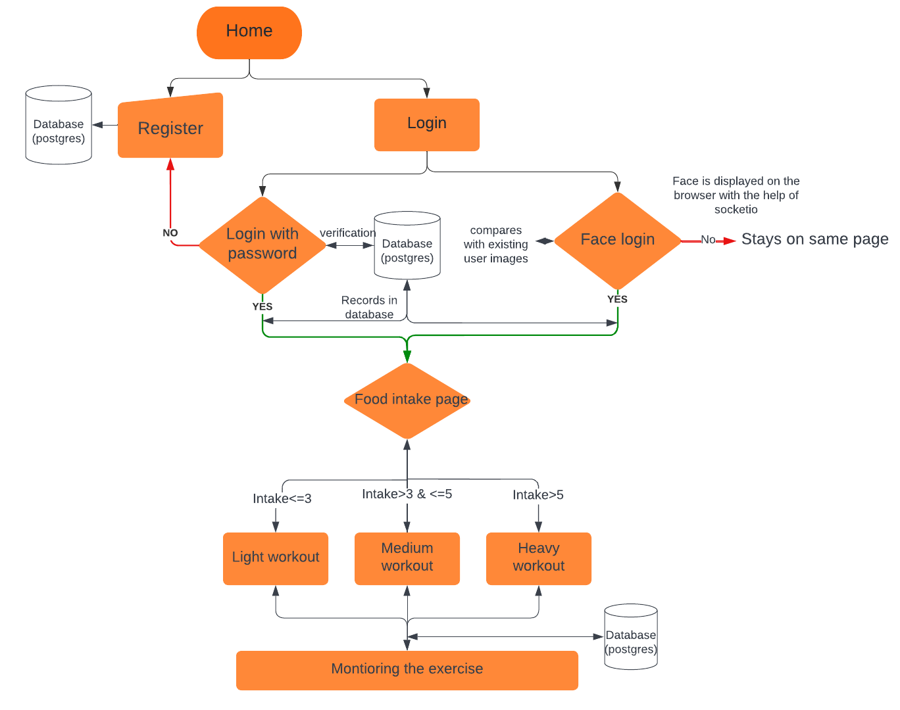
Flowchart

Slide 7
Face Login Data flow architecture:
Source - Device cam
(video feed )
Face Validation
Frames
SocketIO
Result
UI page

Slide 8
Exercise Tracking Data flow architecture:
Source - Device cam
(video feed )
Mediapipe JS
Frames
UI page

Slide 9
Advantages of Fitness Assistant:
Personalized exercise recommendation
Workout anytime anywhere
It's often far more accessible than a personal trainer, which simply makes it easier to get the information you need without having to rely on another human being or keep up with the sometimes extortionate payments.
The sad and annoying truth is that highly qualified personal trainers are often quite expensive. For those who want to achieve their fitness objectives, fitness-based applications powered by artificial intelligence can offer the perfect alternative.

Slide 10

Demo:

Slide 11
Thank you

Slide 12
Questions and Suggestions

